Slide 1
Unit 5 The Network Model
5.1 The Network Model
5.2 IDMS

Slide 2
Data Modeling Issue
Issue: How to represent entities and relationships?
Two major paradigms
Relational
Graph {
E.g., a 'pile' of data
John, 25, NCTU, CS Dept, ...
Mary, 22, NCTU, IS Dept, ...
.
..
COBOL
01 data-record
02 name PIC X(6)
02 age PIC 9(2)
02 univ PIC X(4)
02 dept PIC X(3)
S P SP
Hierarchical
Network
01
02 02 02 02
03 03
01
02 02 02 02
0303

Slide 3
Model 1: Relational
Model 1: Relational
- Decomposition (normalization issue)
Emp
Dept
Project

Slide 4
Model 2: Hierarchical
Dept
Emp
Project

Slide 5
Model 3: Network
Model 3: Network
proposed by CODASYL
Dept
1:M
M : M
Project
Emp
1:M
1:M
E-P

Slide 6
5.1 The Network Model
Data Structure
Consider the 'supplier-and-parts‘ database
S
P
SP
S# SNAME STATUS CITY
S1 Smith 20 London
S2 Jones 10 Paris
S3 Blake 30 Paris
S4 Clark 20 London
S5 Adams 30 Athens
P# PNAME COLOR WEIGHT CITY
P1 Nut Red 12 London
P2 Bolt Green 17 Paris
P3 Screw Blue 17 Rome
P4 Screw Red 14 London
P5 Cam Blue 12 Paris
P6 Cog Red 19 London
S# P# QTY
S1 P1 300
S1 P2 200
S1 P3 400
S1 P4 200
S1 P5 100
S1 P6 100
S2 P1 300
S2 P2 400
S3 P2 200
S4 P2 200
S4 P4 300
S4 P5 400
} Structure
Sample values

Slide 7
The Network Model: Sets and Structure
Network Model
two sets{
Structure
Sample values:
occurrences, data, records
(Ref. next page)
Note:
Three record types: S, P, SP
Two link types: S-SP, P-SP
a set of records (Record types): entities
a set of links (Link types): relationship
S
P
S# SNAME STATUS CITY
S-SP
P-SP
(Links)
SP
QTY

Slide 8
300
200
400
200
100
100
300
400
200
200
300
400
SP
S# P# QTY
S1 P1 300
S1 P2 200
S1 P3 400
S1 P4 200
S1 P5 100
S1 P6 100
S2 P1 300
S2 P2 400
S3 P2 200
S4 P2 200
S4 P4 300
S4 P5 400
The Network Model: Sample Values
P
P1
P2
P3
P4
P5
P6
SP
S
S1 Smith 20 London
S2
S3
S4
S5

Slide 9
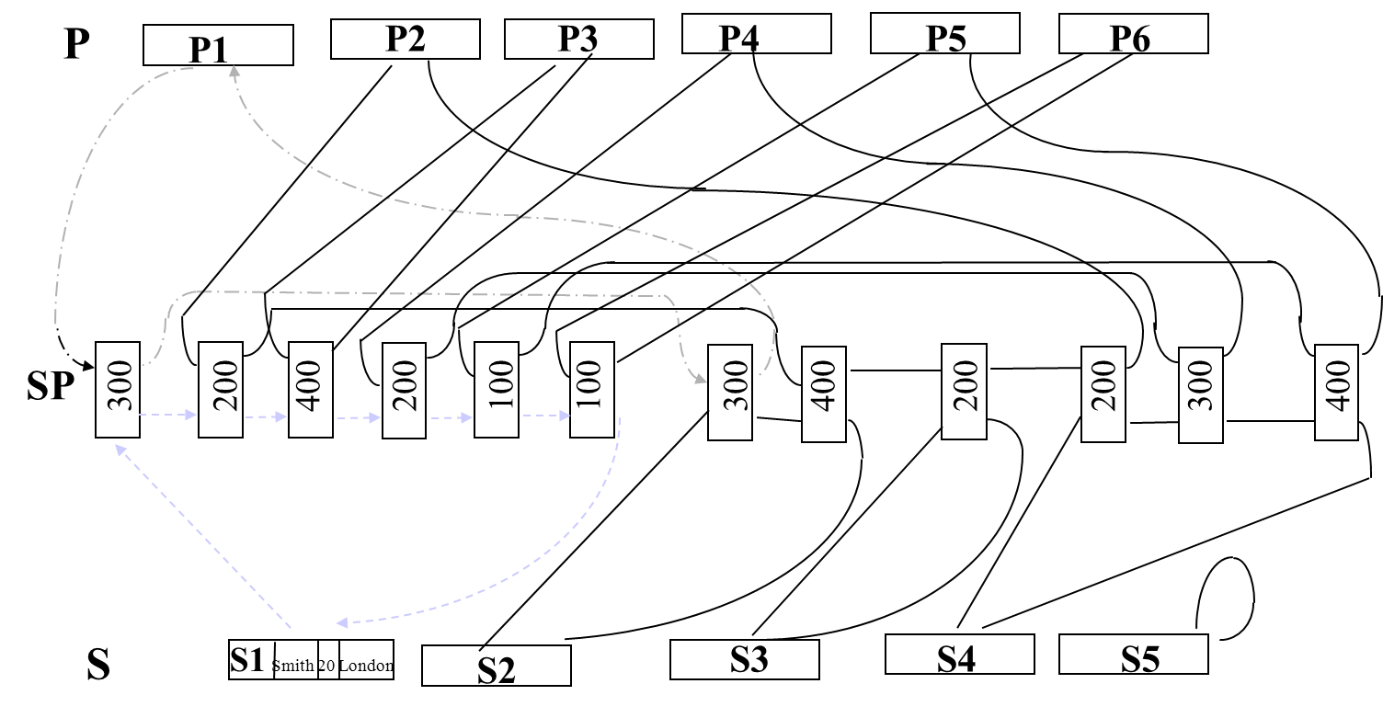
The Network Model: Data Manipulation
Data Manipulation
locate a specific record
move from a parent to its first child
move from one child to the next
.
.
.
create a new record
delete a new record
update a new record
connect a child into a link
Data Integrity
Rule: A child can not be inserted unless its parent already exists

Slide 10
5.2 IDMS: Overview
Runs on IBM mainframes; a product of Cullinet Software
The best known example that based on DBTG (The CODASYL DataBase Task Group)
An IDMS database is defined by DMS Schema DDL (Data Definition Language)
Schema defines:
(1) records in the database
(2) elements (i.e. fields)
(3) sets (i.e. links)
owner (parent)
member (child)
S
P
SP

Slide 11
IDMS: Data Structure
Consider the data structure of the "suppliers-and-parts" database:
S
P
S#
P#
S-SP
SP
P-SP
QTY
an extended form
system
S-File
P-File (system link)
S
P
S#
P#
Note: It may be convenient regarding all roots as children of a hypothetical system record.
S-SP
SP
P-SP
QTY

Slide 12
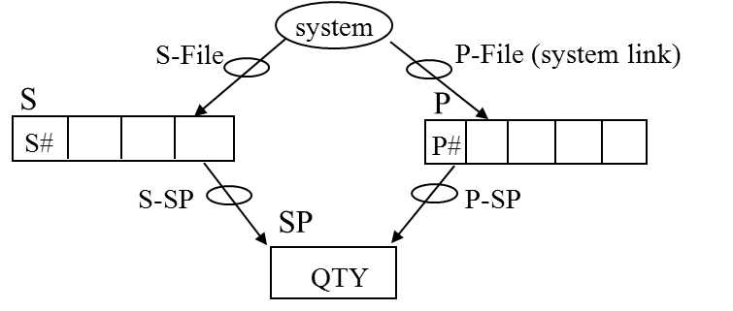
IDMS: Schema
1 SCHEMA NAME IS SUPPLIERS-AND-PARTS
2 RECORD NAME IS S.
3 LOCATION MODE IS CALC USING S#
4 DUPLICATES NOT ALLOWED.
5 02 S# PIC X(5).
6 02 SNAME PIC X(20).
7 02 STATUS PIC 999 USAGE COMP-3.
8 02 CITY PIC X(15).
9 RECORD NAME IS P.
10 LOCATION MODE IS CALC USING P#
11 DUPLICATES NOT ALLOWED.
12 02 P# PIC X(6).
13 02 PNAME PIC X(20).
14 02 COLOR PIC X(6).
15 02 WEIGHT PIC 999 USAGE COMP-3.
16 02 CITY PIC X(15).
17 RECORD NAME IS SP.
18 LOCATION MODE IS VIA S-SP SET.
19 02 QTY PIC 99999 USAGE COMP-3.
20 SET NAME IS S-SP.
21 ORDER IS NEXT.
22 OWER IS S.
23 MEMBER IS SP OPTIONAL MANUAL.
24 SET NAME IS P-SP.
25 ORDER IS NEXT.
26 OWNER IS P.
27 MEMBER IS SP OPTIONAL MANUAL.
28 SET NAME IS S-FILE.
29 ORDER IS SORTED.
30 OWER IS SYSTEM.
31 MEMBER IS S MANDATORY AUTOMATIC
32 ASCENDING KEY IS CITY.
33 SET NAME IS P-FILE.
34 ORDER IS SORTED.
35 OWNER IS SYSTEM.
36 MEMBER IS P MANDATORY AUTOMATIC
37 ASCENDING KEY IS COLOR.

Slide 13
IDMS: Subschema “View”
1 ADD SUBSCHEMA NAME IS S-AND-P-ONLY
2 OF SCHEMA NAME IS SUPPLIERS-AND-PARTS.
3 ADD RECORD S.
4 ADD RECORD P
5 ELEMENTS ARE
6 P#
7 COLOR
8 CITY.
9 ADD SET S-FILE.
10 ADD SET P-FILE.
Subschema name
S-File P-File (system link)
S P
P# COLOR CITY
system

Slide 14
IDMS: Data Manipulation
Working area:
Currency indicator: similar to current of cursor in SQL, and current position in IMS
COBOL
.
.
.
record description
.
.
.
}
for each subschema record type to be processed
(i.e. UWA working area in DBTG)
77 ICB (IDMS Communication Block) (ref 4-9)
(similar to SQLCA in DB2)
error-status

Slide 15
IDMS: Data Manipulation (cont.)
Selected commands:
Bind: Associates IDMS record types and control blocks with space
Ready:Prepares database areas for processing
Commit: Effects a checkpoint for recovery procedures
Rollback: Requests recovery of the database
Finish: Releases database areas
Find: Locates a record occurrence in the database
Get: Delivers a record occurrence to variable storage
Store: Adds a record occurrence to the database
Modify: Rewrites a record occurrence in the database
Connect: Links a record occurrence to a set
Disconnect: Dissociates a record occurrence from the database
Erase: Deletes a record occurrence from the database
If: Tests whether a set is empty or whether a record occurrence is a member
Keep: Locks a record occurrence against access or update by another run unit
…

Slide 16
end of unit 5

